Slide 1






AI-DRIVEN ENTITY INTELLIGENCE & RISK ANALYSIS
By Ctrl+Alt+Defeat

Slide 2
TEAM MEMBERS
Manish Kumar Shikarbar:CT
Prasoon Soni:CT
Anushka Anand:WIMT
Merin Thomas:TCOO
Swastika Pandey:CCIBT

Slide 3
PROBLEM STATEMENT
Financial institutions struggle with detecting money laundering, fraud, and sanctions violations due to manual processes, fragmented data, and evolving fraud tactics. This project automates entity verification, fraud detection, and risk scoring using Generative AI, Machine Learning, and real-time data enrichment from sources like OpenCorporates, OFAC, FATF, and financial news. It extracts transaction details, identifies high-risk entities, and assigns risk scores with confidence levels. By integrating LLM-powered sentiment analysis and anomaly detection, the system enhances financial security, reduces compliance costs, and improves risk assessment accuracy, providing real-time risk reports and monitoring.

Slide 4
EXISTING CHALLENGES
01.
Manual & Inefficient Risk Assessment
02.
Fragmented Data Sources
03.
Inconsistent & Unstructured Data
04.
Complex Fraud Detection
05.
06.
Lack of Transparency in Risk Scoring
Regulatory & API Limitations

Slide 5
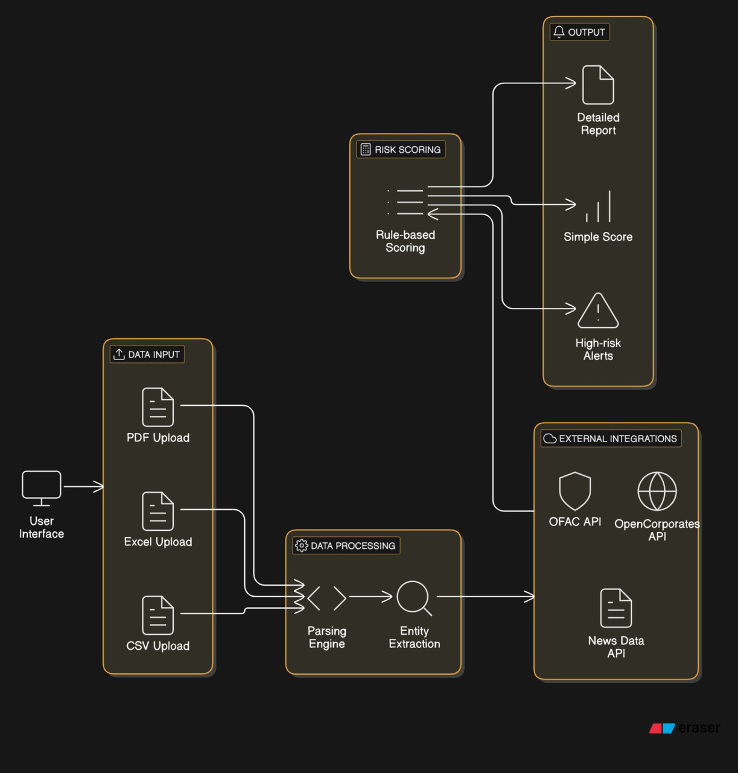
ARCHITECTURE

Slide 6
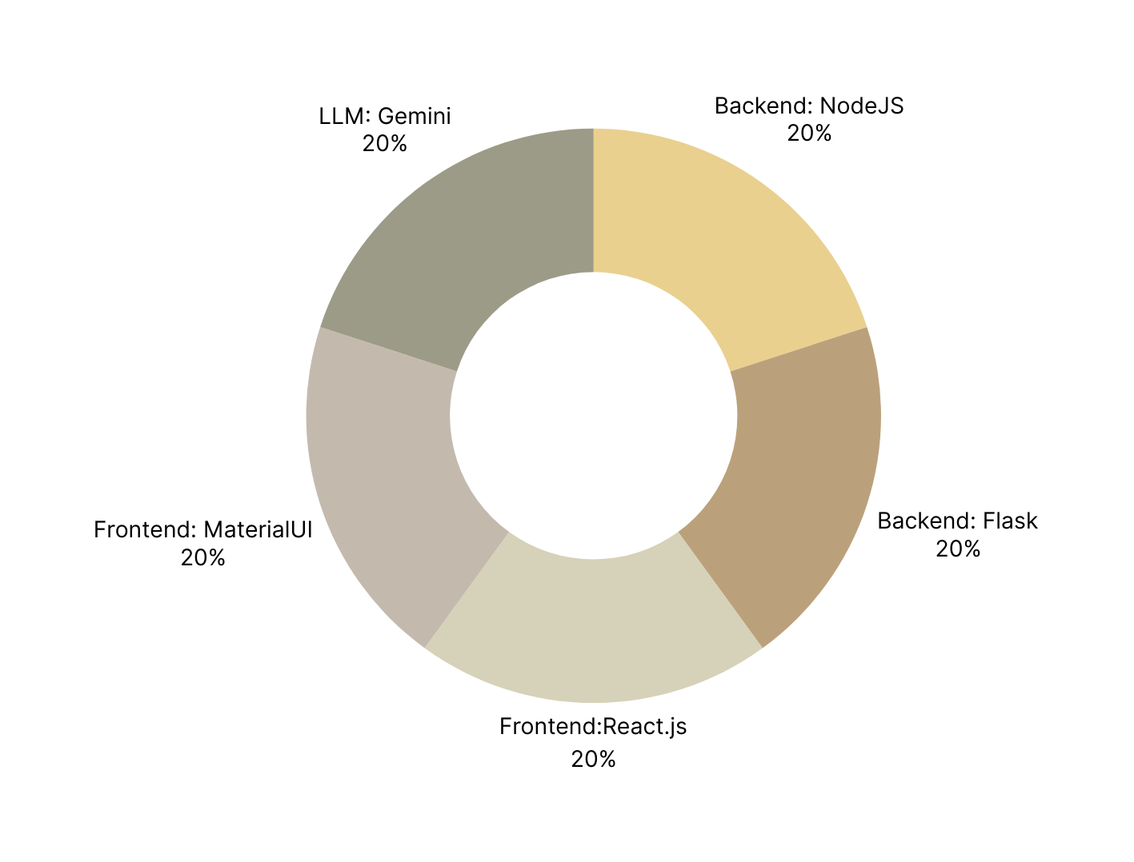
TECH STACK USED

Slide 7
SOLUTION
Parsing Transaction Data :
Extracts details from PDFs, CSVs, and text using Google Gemini.
Entity Extraction & Enrichment :
Identifies sender & receiver, verifies them via OpenCorporates, OFAC, FATF, SEC EDGAR, and Wikidata.
Risk Prediction Using ML Model :
XGBoost model analyzes entity details to predict fraud & compliance risks.
News & Social Media Analysis :
Google Gemini fetches real-time news & sentiment analysis for risk indicators.

Slide 8
Comprehensive AI Analysis :
LLM (GPT-4/Gemini) generates a detailed risk report combining transaction details,
ML predictions & news insights.
Risk Score & Confidence Calculation :
Aggregates results to assign final risk & confidence scores.
Report Generation & API Output :
Provides a structured JSON risk report with evidence & justifications for compliance teams.
Dashboard for Monitoring (React & MUI) :
Real-time risk monitoring & entity search interface for financial institutions.

Slide 9
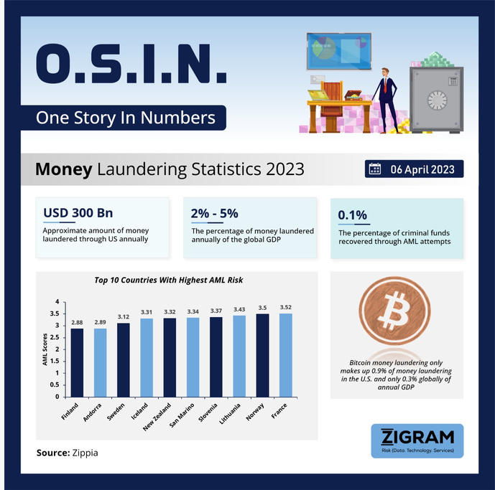
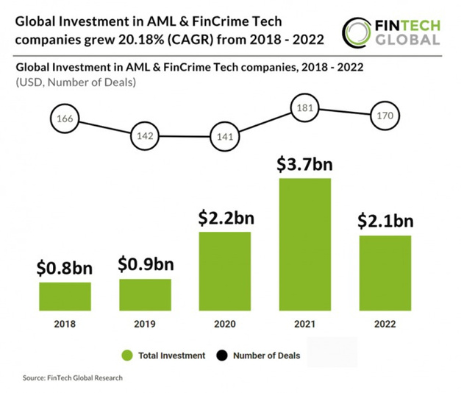
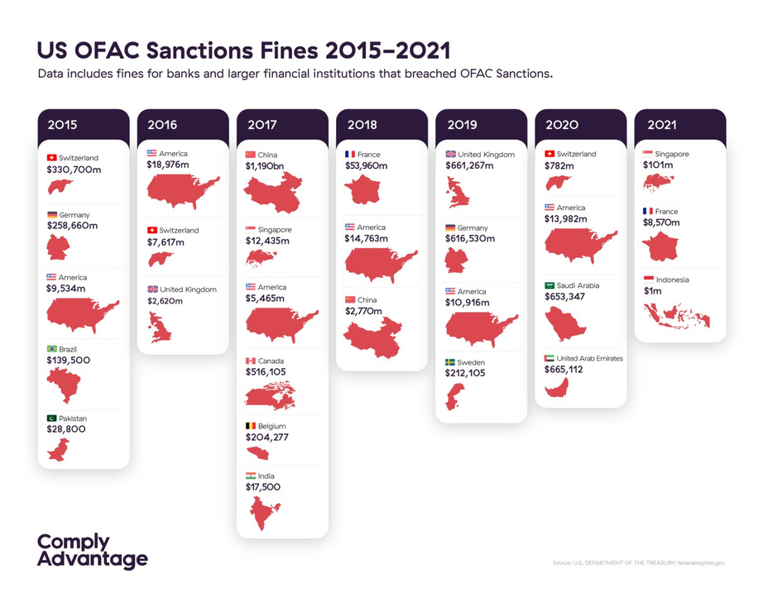
DATASOURCES

Slide 10
IMPACT AND SCALABILITY
Our AI-driven risk assessment system revolutionizes financial compliance by automating entity verification, fraud detection, and risk scoring, significantly reducing manual workload and compliance costs.
By leveraging real-time data from multiple global regulatory sources, the system enhances fraud detection accuracy while minimizing false positives. This ensures that financial institutions can proactively identify high-risk entities, preventing money laundering, sanctions violations, and illicit financial activities. Designed for high scalability, the system processes millions of transactions in real time, utilizing a cloud-native architecture for seamless integration with banking, fintech, and regulatory platforms. Its API-driven framework allows flexible deployment, making it adaptable for organizations of all sizes.
With asynchronous processing, caching mechanisms, and AI-driven optimizations, the system ensures efficient, high-performance risk monitoring, enabling financial institutions to stay ahead of evolving fraud tactics and regulatory challenges.

Slide 11
ADVANTAGES OVER OTHER SOLUTIONS
Unlike traditional compliance tools that rely on manual reviews and static rule-based checks, our AI-powered system leverages Machine Learning, LLMs, and real-time data aggregation to deliver faster, more accurate risk assessments. Existing solutions often produce high false positives due to rigid rule-based frameworks, whereas our approach combines multi-source intelligence from OFAC, FATF, SEC, OpenCorporates, Wikidata, and financial news to enhance precision. Additionally, most fraud detection models operate as black-box systems, making it difficult for compliance teams to understand why an entity is flagged. Our system overcomes this by generating LLM-powered, human-readable justifications for every risk score. It also integrates real-time news sentiment analysis, allowing for early detection of negative media exposure and financial crime links, something that traditional systems lack. Designed for high scalability, our cloud-native, API-driven solution easily integrates with banking, fintech, and regulatory platforms, ensuring seamless adoption. By merging automated data enrichment, AI-driven anomaly detection, and transparent risk explanations, our system significantly reduces manual
effort, enhances fraud detection, and improves regulatory compliance in real-time.

Slide 12
FUTURE SCOPE
As financial fraud tactics evolve, our solution will continuously improve by integrating advanced AI models, real-time blockchain monitoring, and expanded global regulatory data sources. Future enhancements include deep-learning-based fraud pattern recognition, allowing the system to detect hidden relationships between entities more effectively.
We aim to implement automated transaction blocking mechanisms for high-risk entities and expand KYC (Know Your Customer) and AML (Anti-Money Laundering) capabilities.
Additionally, incorporating self-learning AI models will enable dynamic risk scoring based on emerging fraud trends and geopolitical events. Scalability improvements will focus on cloud-native microservices architecture, allowing seamless integration with banking, fintech, and regulatory platforms worldwide. Future versions will also provide interactive dashboards with predictive analytics, empowering compliance teams with proactive risk mitigation insights.

Slide 13
THANK
YOU

